Slide 1




Spatial analysis Project (CS621B)
Spatial Analysis of Least Accessible Mineral Deposits in South Africa
STUDENT NAME : DEVANAHALLIBOKKSAM SREEVATHSA
STUDENT ID : 21250214

Slide 2

Do you have any idea why China is more interested in South Africa than other African nations?

Slide 3
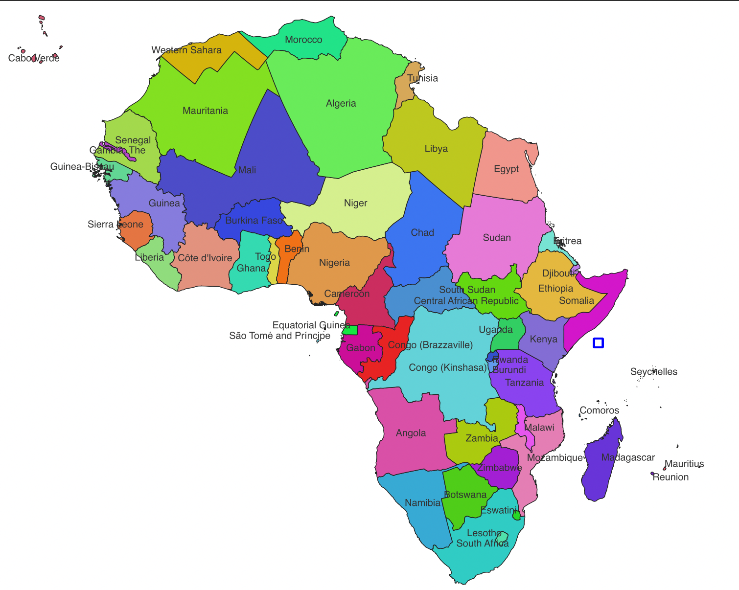
Africa has a plethora of highly rich and economically recoverable natural resources buried beneath its surface, making its mining industry one of the most important in the world.
Mineral exploration and production are crucial elements of the economy of many African countries, and they remain critical contributors to the economy.
Africa has significant stocks of metals and minerals such as gold, diamond, cobalt, bauxite, iron ore, coal, and copper, and is a major producer of many essential mineral commodities.
South Africa, Namibia, Zimbabwe, The Democratic Republic of Congo (DRC) are all prominent mining countries in Africa.

Slide 4
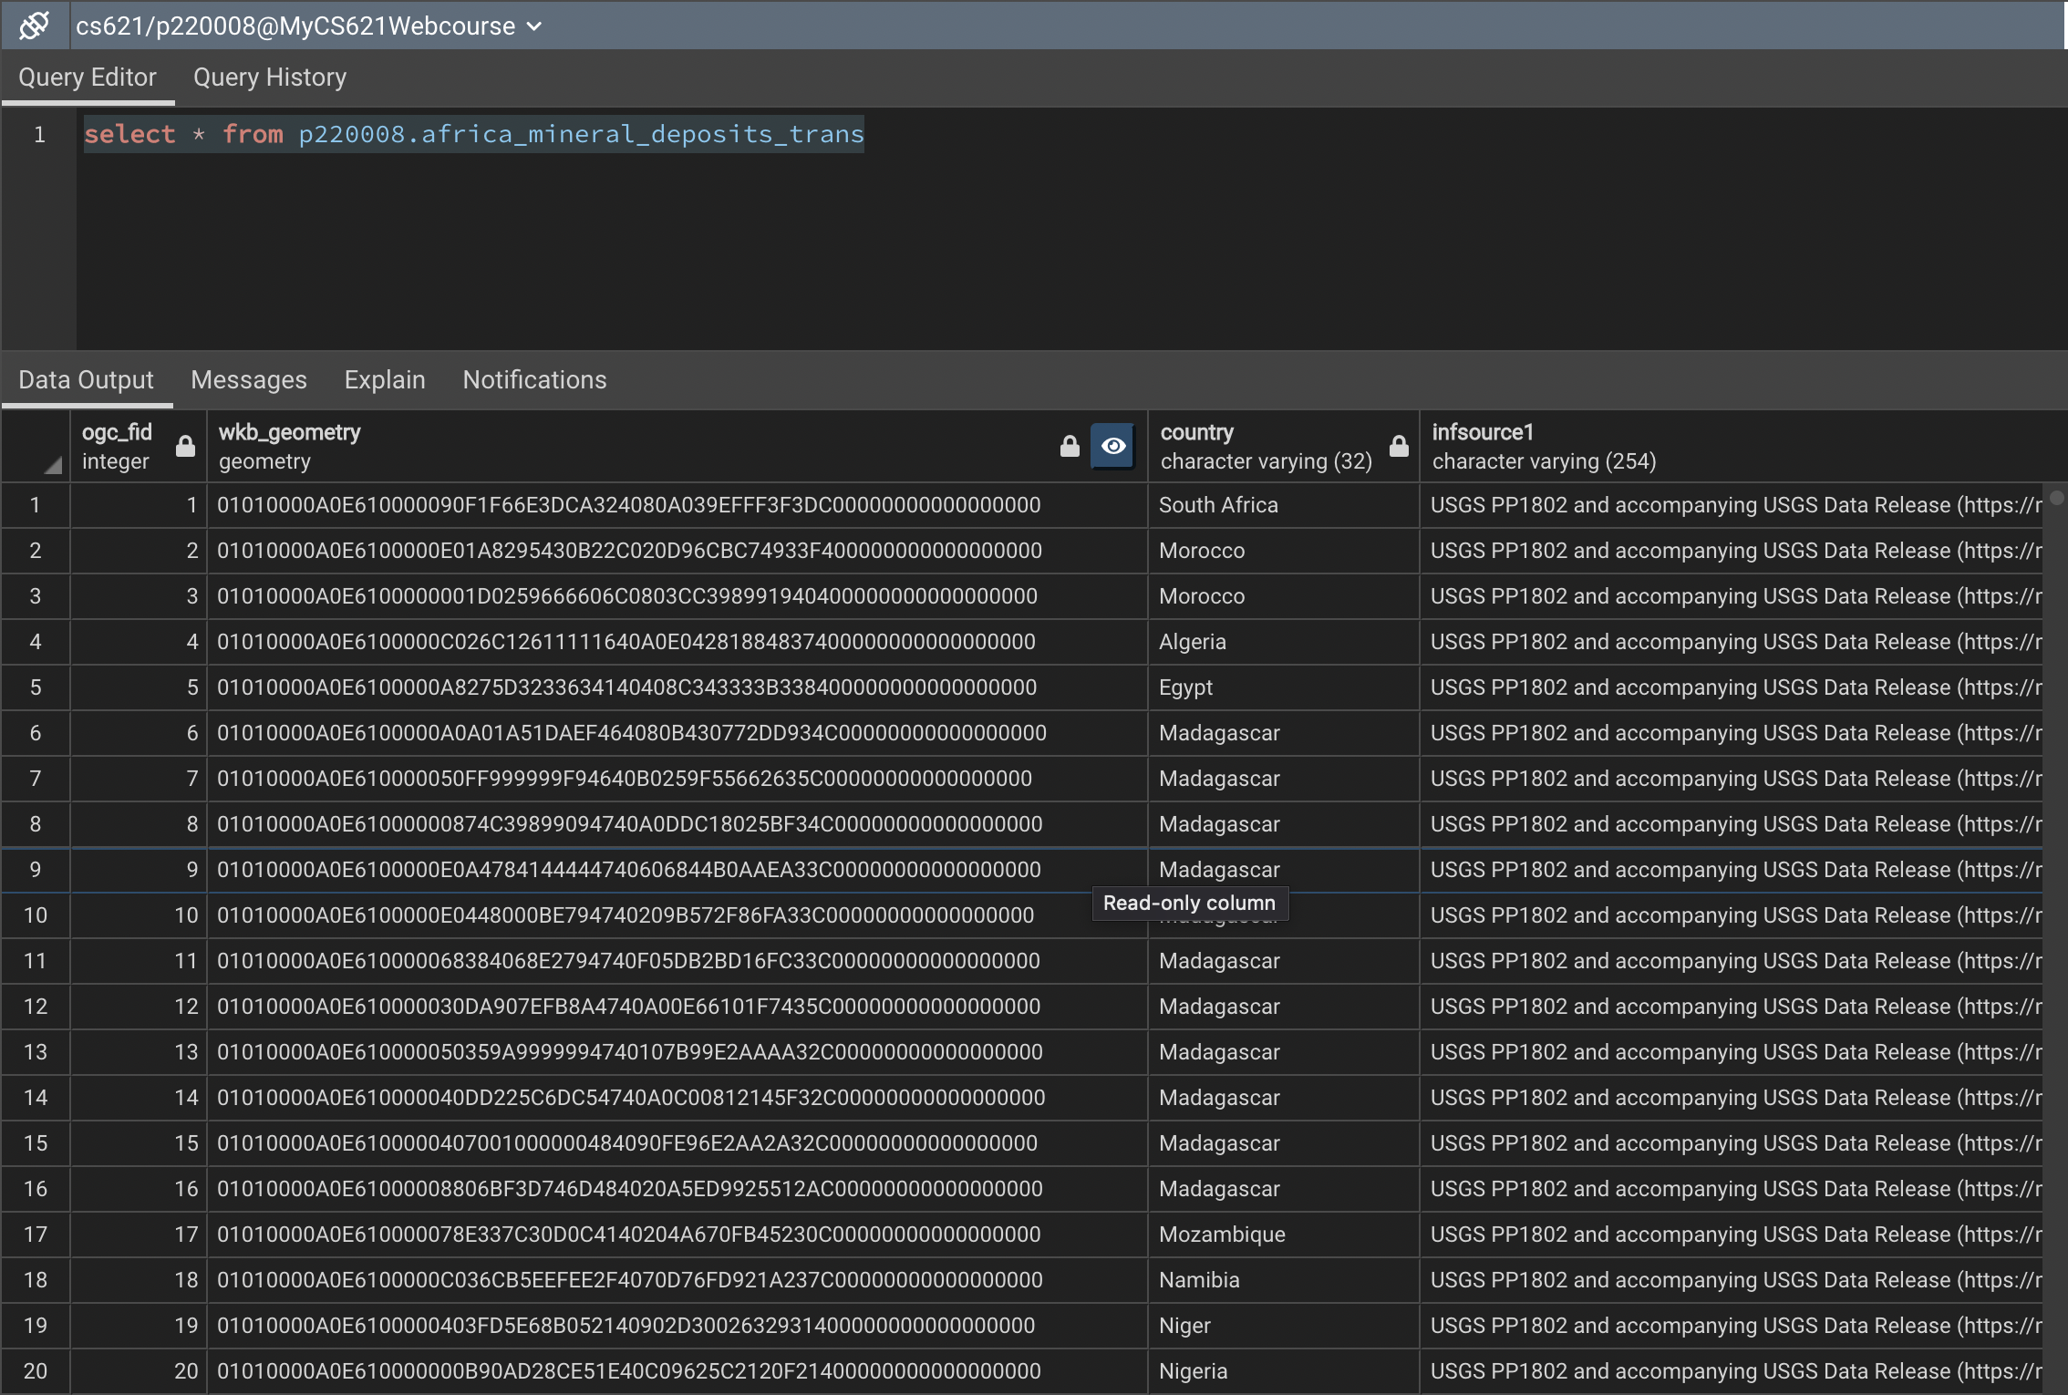
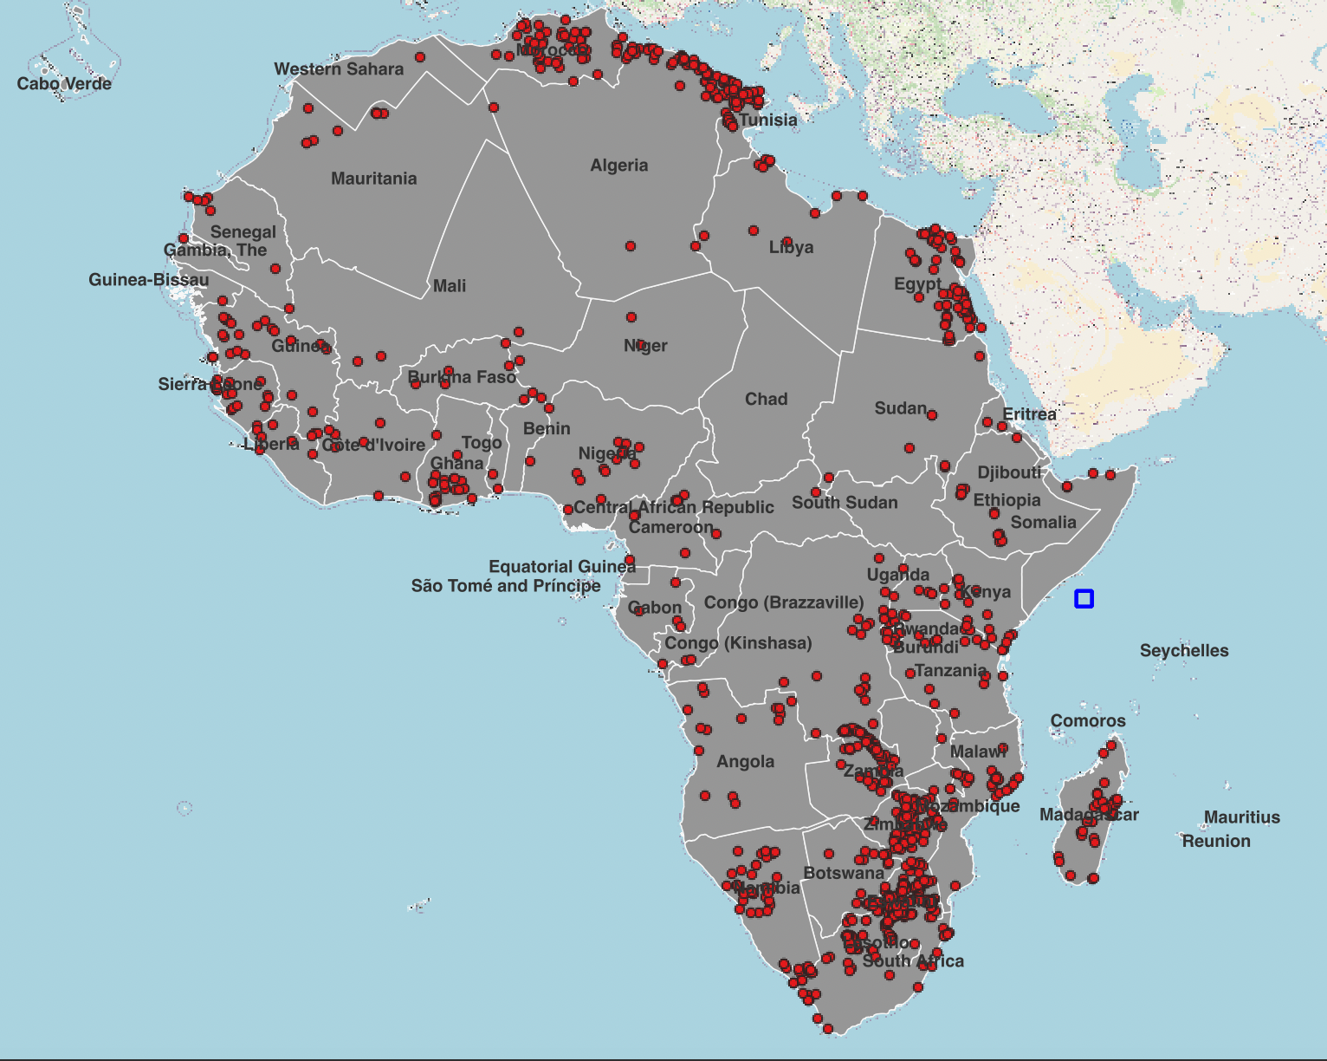
GEO-SPATIAL VIEW OF African Mineral Deposits

Slide 5
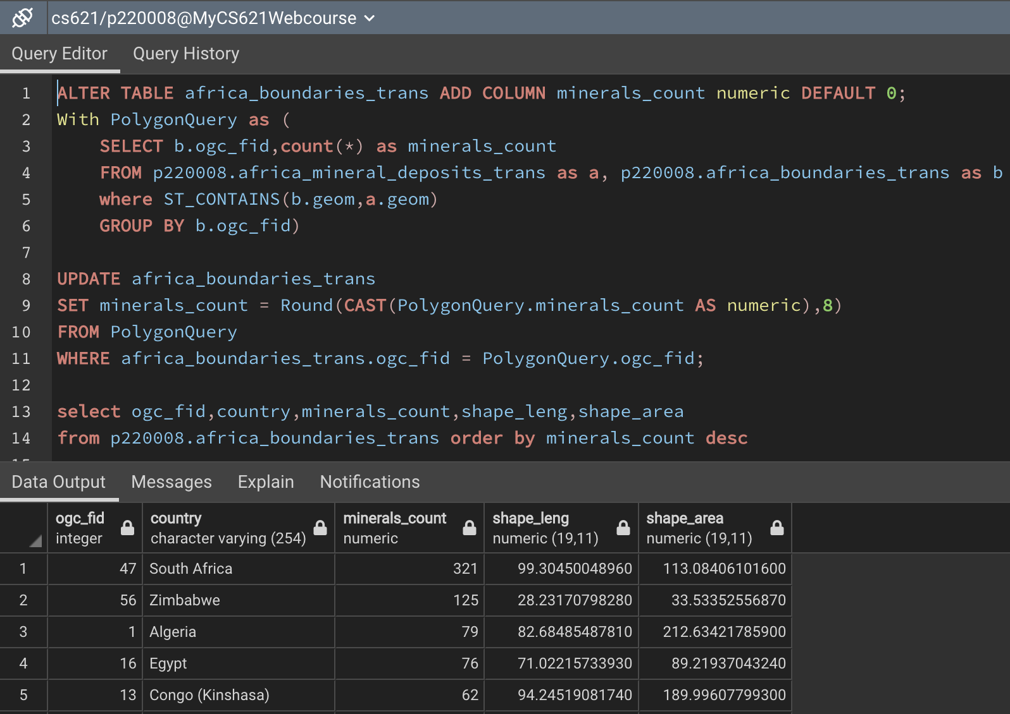
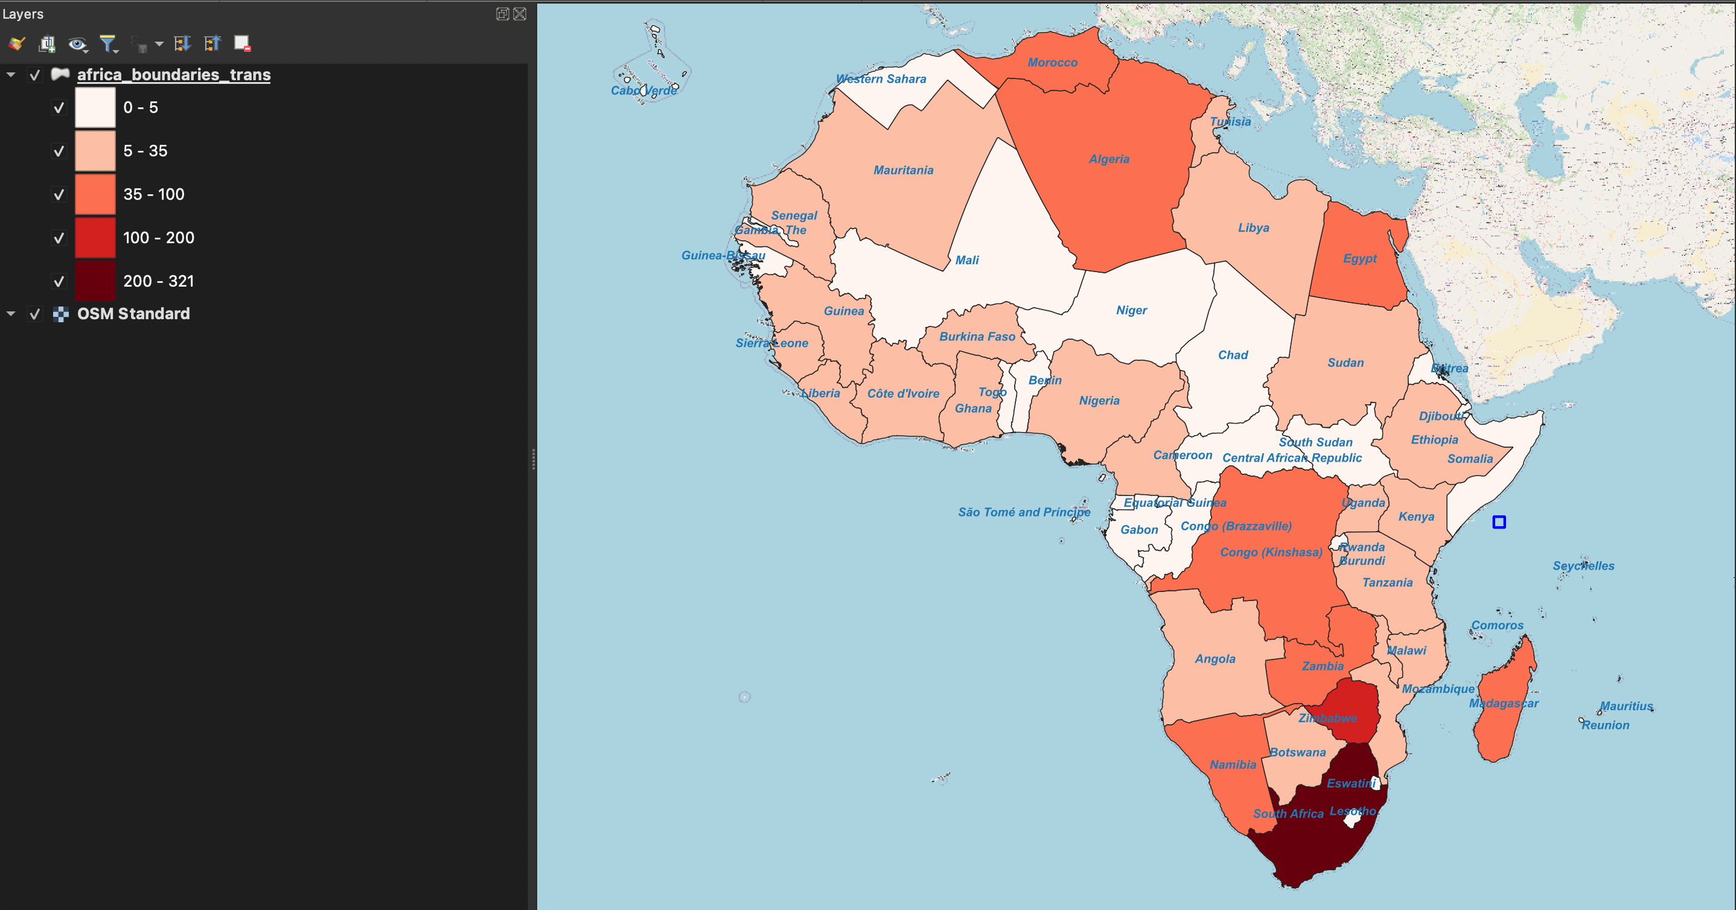
Mineral reserves in each African country visualised using a count-based approach.
With 321 mineral reserves, South Africa is the most mineral-rich country in Africa.
South Africa

Slide 6
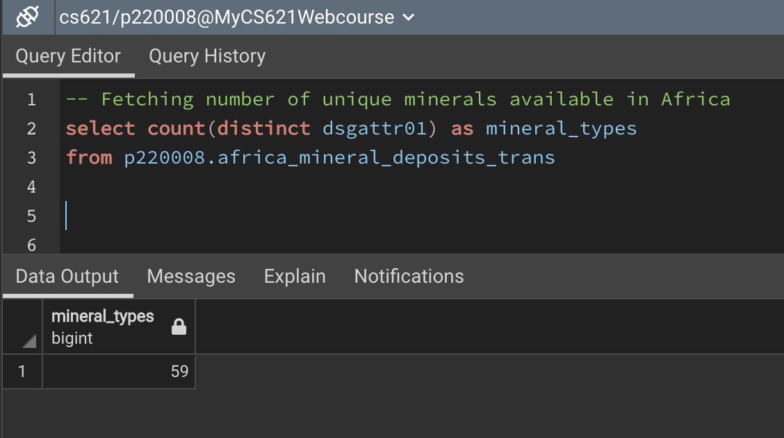
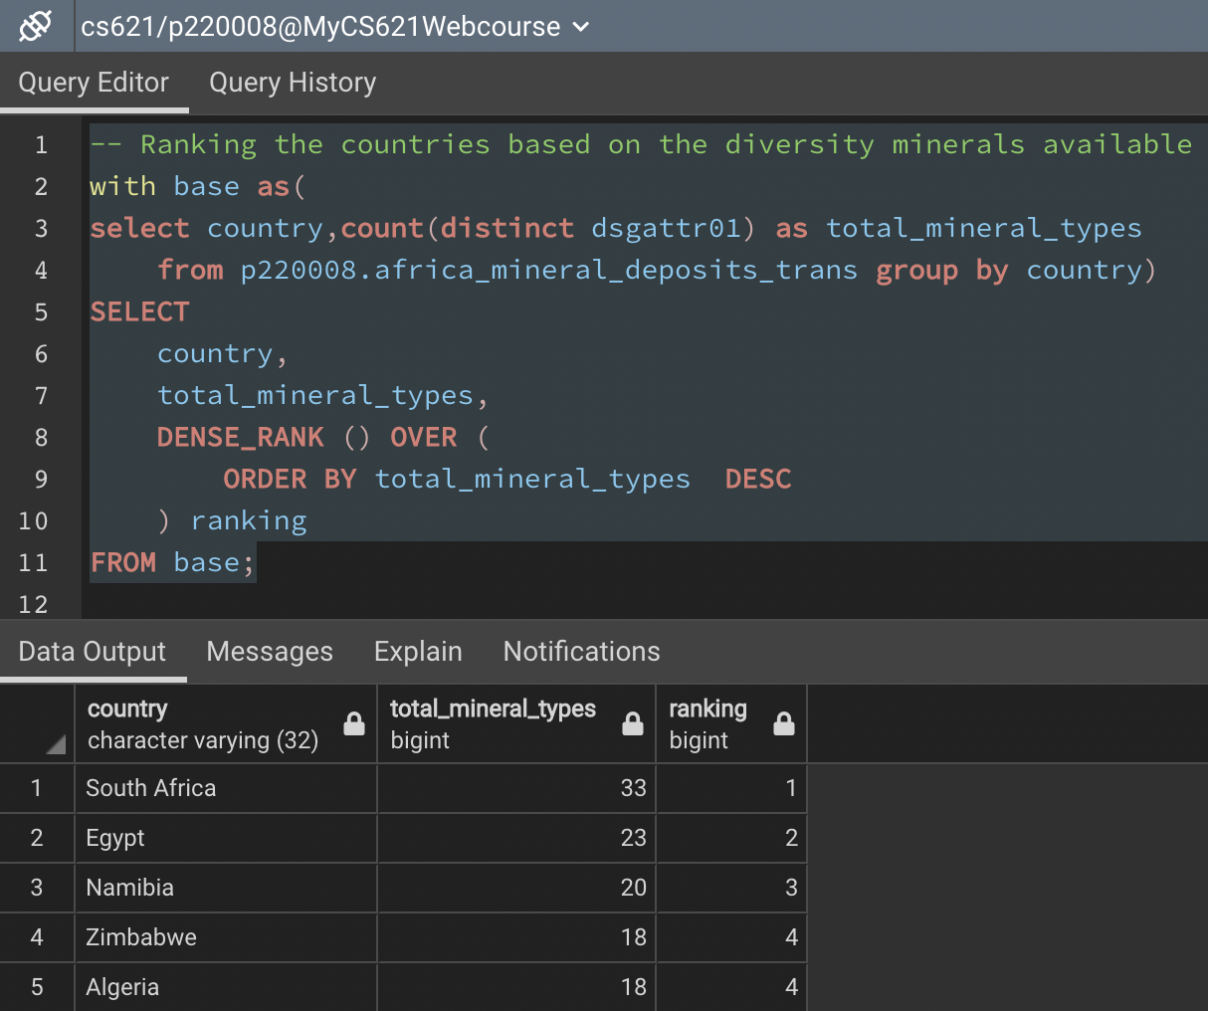
Analyzing diversity of mineral in each African country
Among 59 varieties of mineral available in Africa, 33 wide varieties were found in South Africa which tops among all other African Countries.

Slide 7
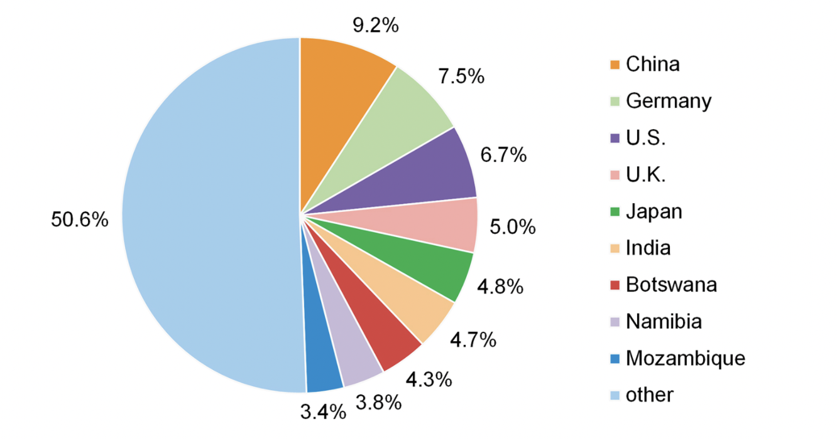
South Africa's major trading countries
6-billion. Ores, iron and steel, wood pulp, copper, and fruit and nuts were the top five items sent to China in 2019, accounting for 88 percent of the entire value of South Africa's exports to China.

Slide 8
Problem Statement
Chinese investors and the South African Department of Mineral Resources want to work together to identify and build transportation infrastructure around mines with the most challenging port access.
Identifying the problem statement involves a series of steps.
Create a VIEW that separates South African data from data from the rest of Africa.
Create a 10-kilometer buffer zone around each mineral deposit.
Identify and filter the buffer points that do not intersect with any railway tracks.
Using the resulting points from Step 3, identify the buffer points that do not intersect with any highways and filter those points.
The last points are those with the least amount of transit access to the port.

Slide 9

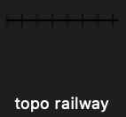
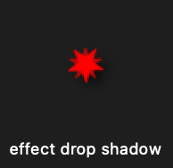
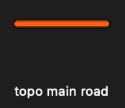
Important Assumptions :
1) All ports, we know, have either rails or roads.
2) Railways would be the primary mode of transport for minerals, followed by highways.
3) Railways and roadways that are being plotted are the only ones that are legally permitted to transmit minerals.
Labels :
Mineral Deposits
Railways
Harbor Ports
Roadways

Slide 10
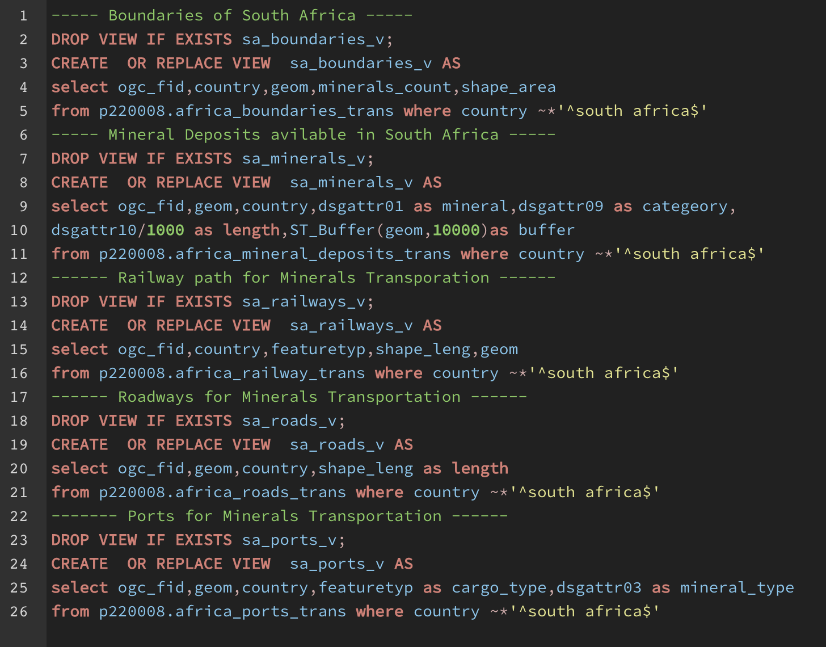
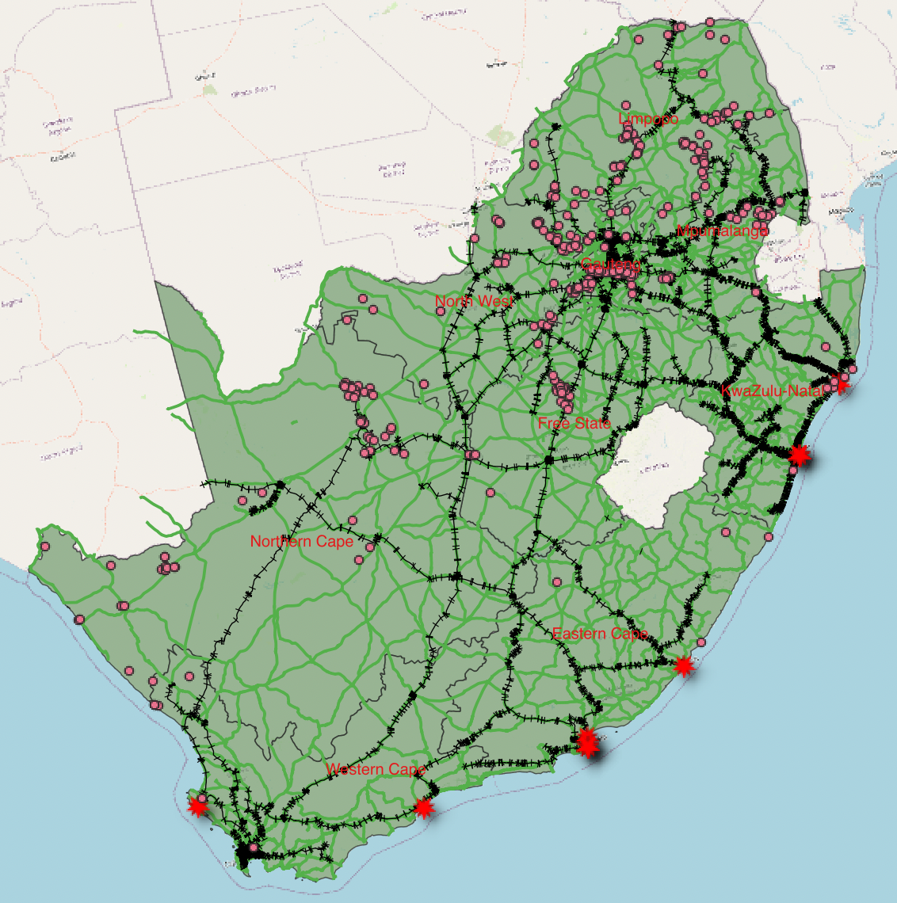
Step 1 : Create And Visualize Views
Filter and create a view from Africa's dataset that only contains data for South Africa and Visualize in QGIS.
ROADS
MINERALS
RAIL PATHS
PORTS

Slide 11
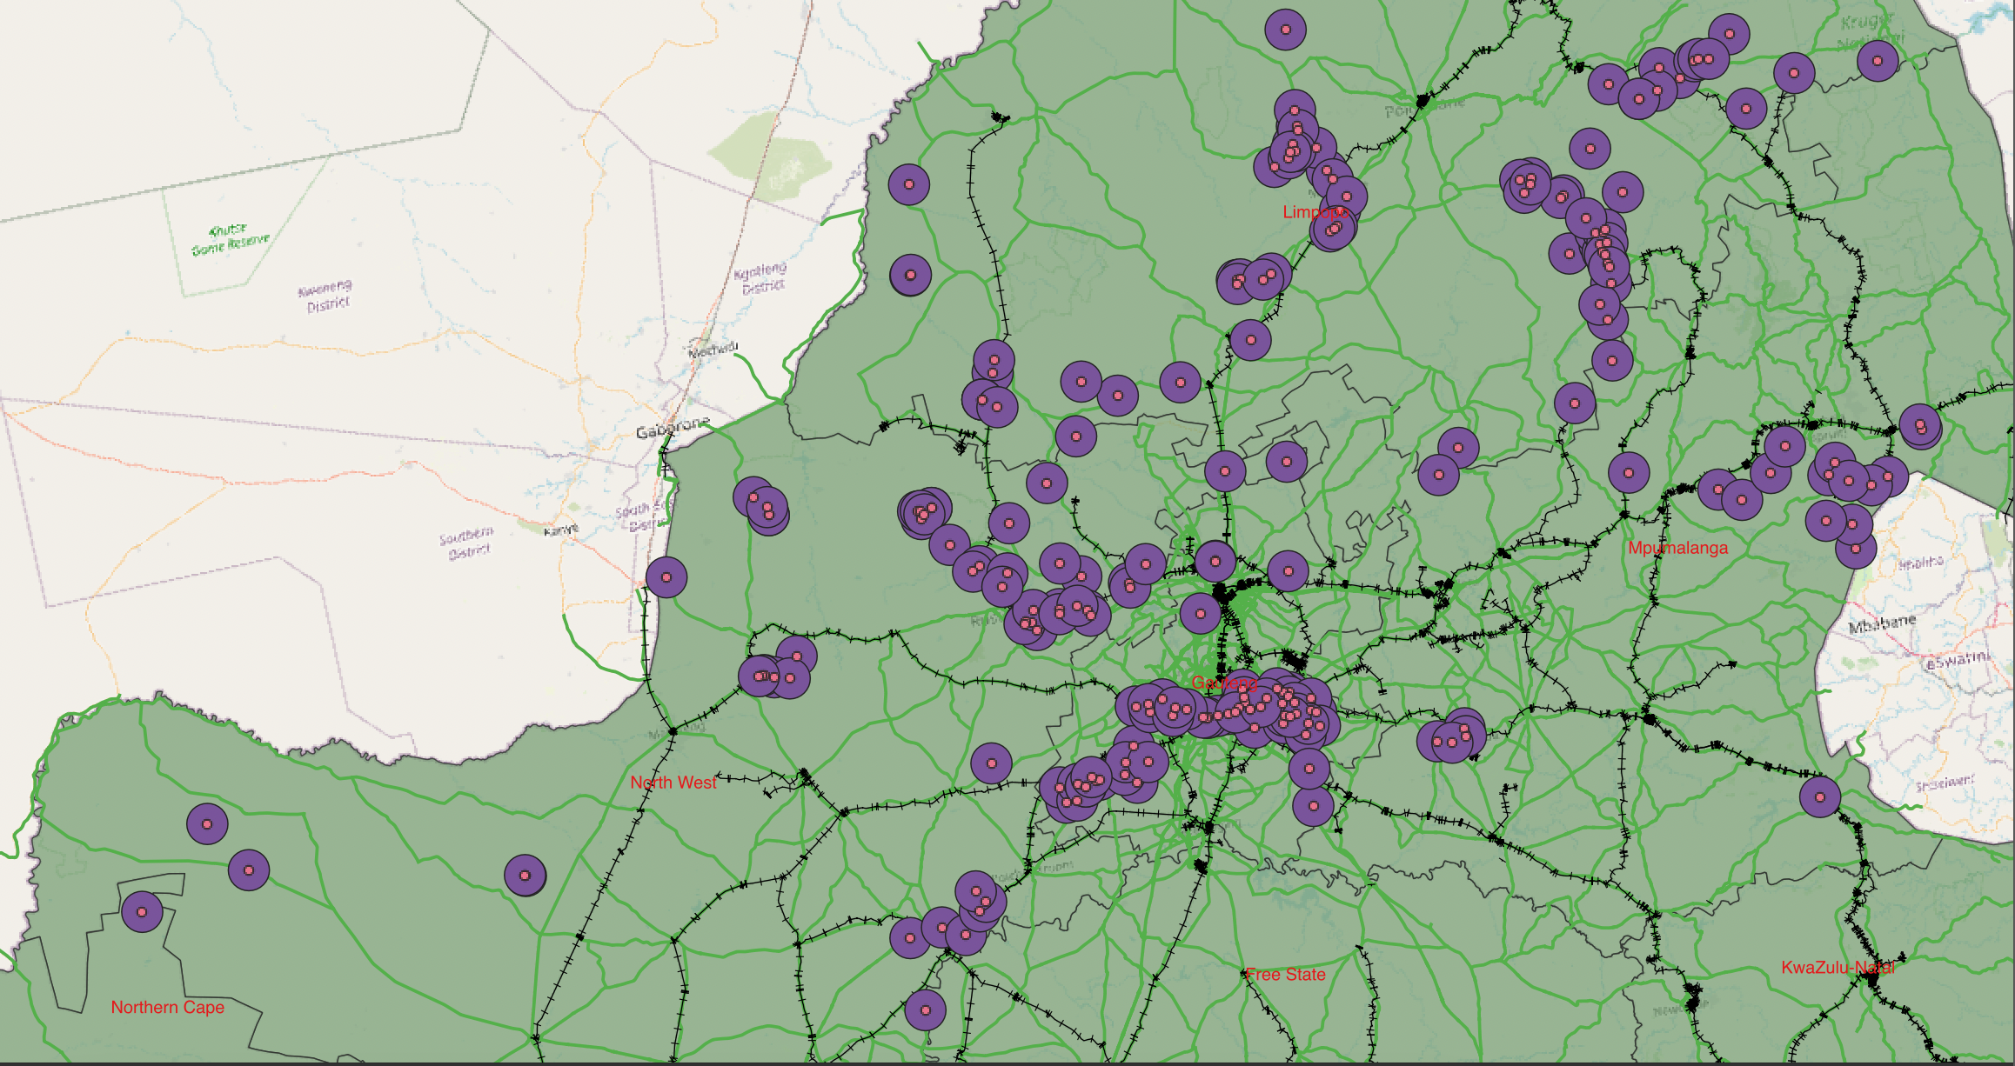
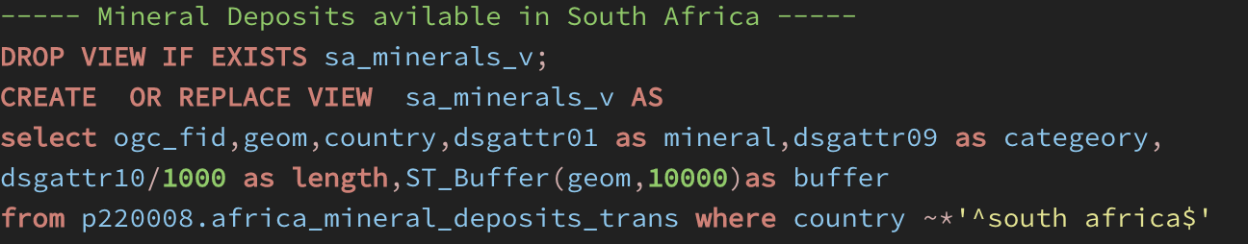

Step 2 : Create a buffer around Minerals
BUFFER

Slide 12
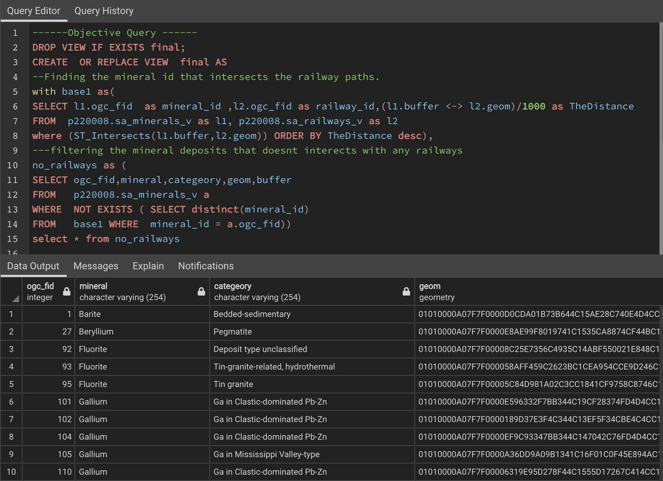
Step 3 : Identify and filter the points that do not intersect Railways
These are the Buffer points that don't intersects with railways which is primary mode of transporting minerals.
Next, identifying the deposits that don’t intersect with roadways.

Slide 13
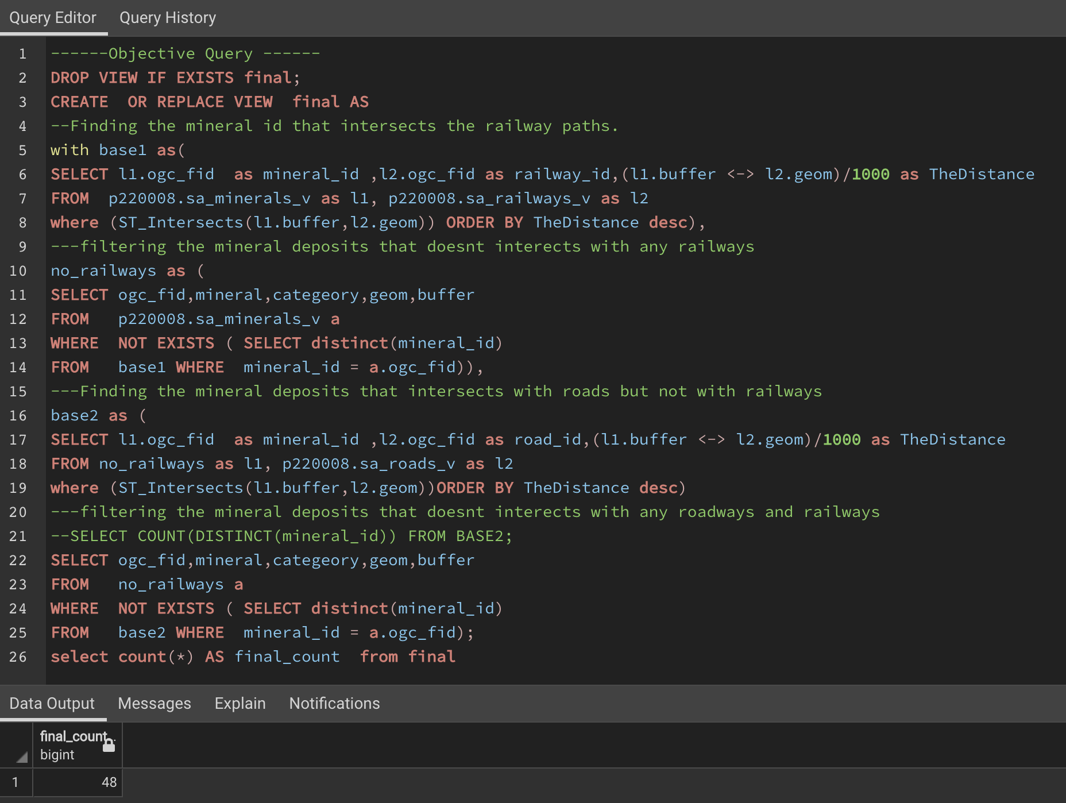
Step 4 : Identify and filter the points that do not intersect roadways
There are 48 mineral resources which aren't near either trains or highways.

Slide 14
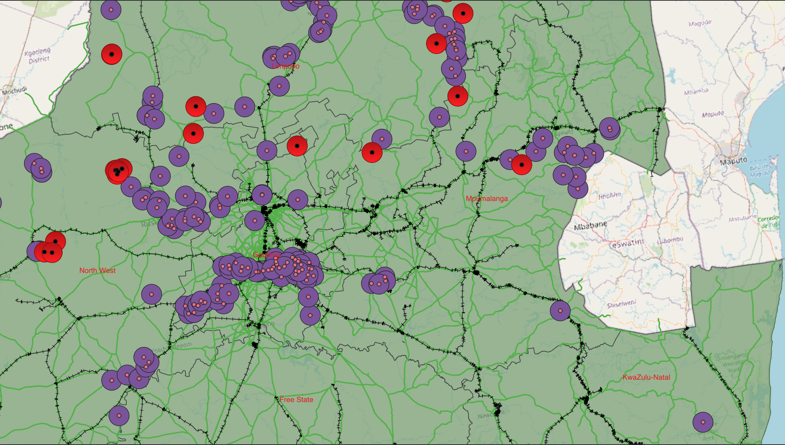
Step 5 : Resultant Points in GEO-SPATIAL Representation
The red points are those that lack either trains or roadways, whereas the purple points are well linked.

Slide 15
Conclusion
Upon an investigation, it is discovered that the transportation infrastructure surrounding 48 mineral reserves must be improved in order to speed up mineral distribution to ports.

Slide 16


Thank You

